Slide 1
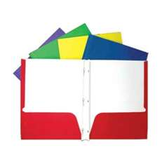
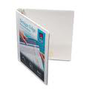
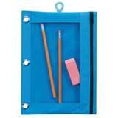
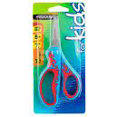
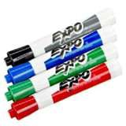
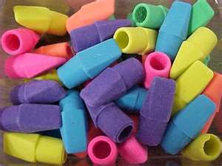
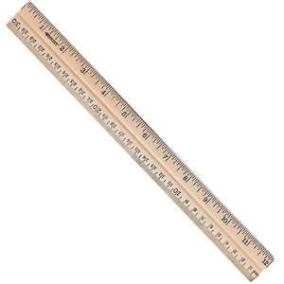
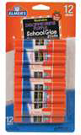
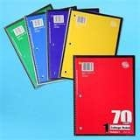
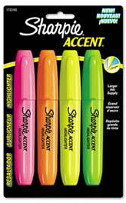
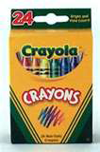
Moss Park Elementary 3rd Grade Supplies 2014-2015
2 packs wide-ruled notebook paper
8 solid color folders w/prongs and pockets ( Two of each: red, yellow, blue & green)
4 solid color spiral notebooks (red, yellow, blue & green)
2 Boxes of 24-count of Crayola crayons
1 Box of Colored Pencils
1 pair of Fiskar scissors
2 glue sticks
1 bottle of Elmer’s Glue
3 packs of 24 #2 pencils
24 pencil top erasers
2 pack of 4 EXPO dry erase markers
1 Pack of RED Bic pens
1 pack of 4 multi-colored highlighters
1 large pencil bag
Individual student headphones
2 binders ( 1½ in. wide with clear pocket in front)
2 pack of subject dividers
1 foot ruler with inches and centimeters
3 reams of white copy paper
1 pack of 25 sheet protectors
2 boxes of tissues
2 Clorox wipes
1 Bottle of liquid soap
Boys | Girls
Gallon zip lock bags Band-aids | Sandwich size zip lock bags Hand sanitizer

